Slide 1

Smart parking slot monitoring system
Iot project presentation by balint bujtor

Slide 2
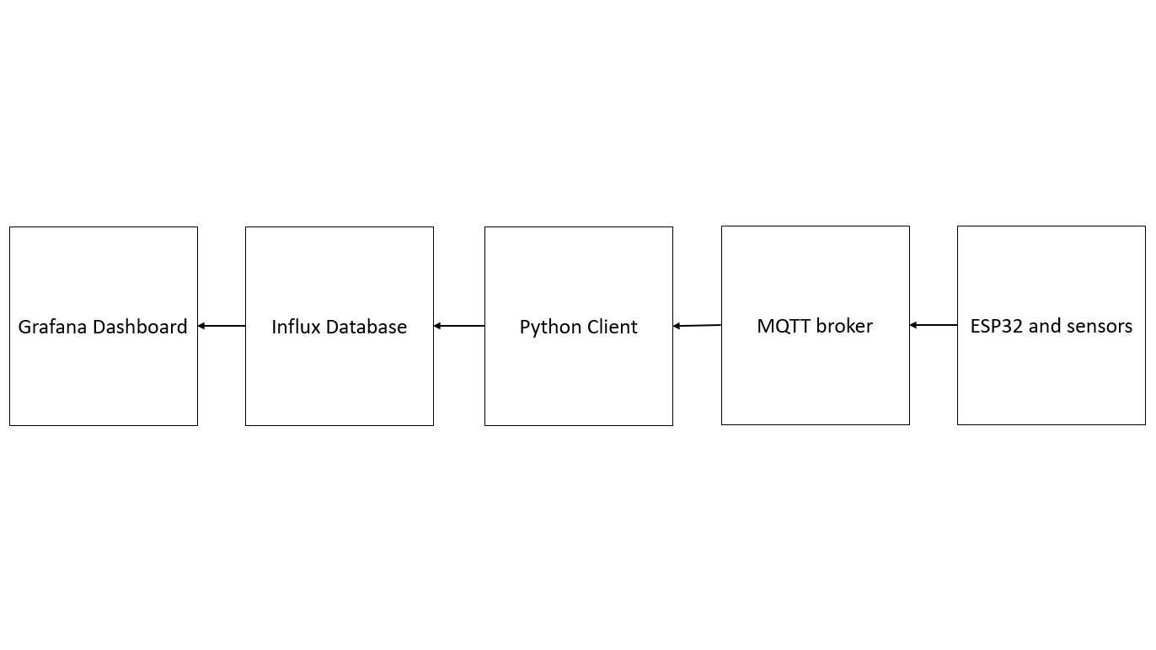
Project architecture

Slide 3
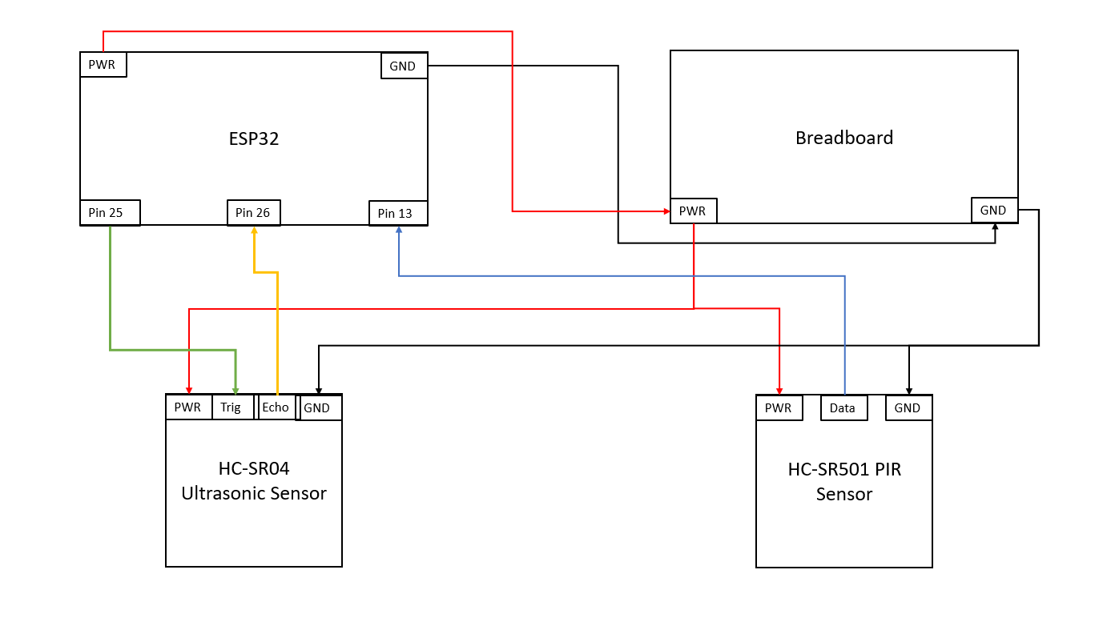
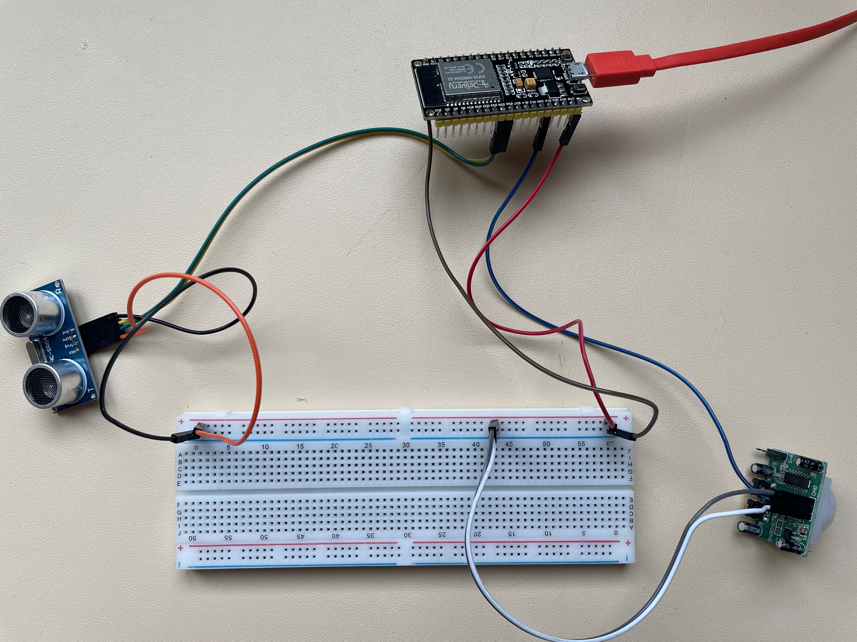
Hardware structure

Slide 4
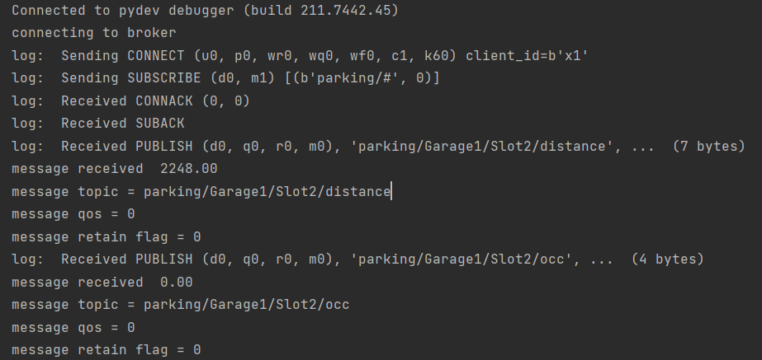
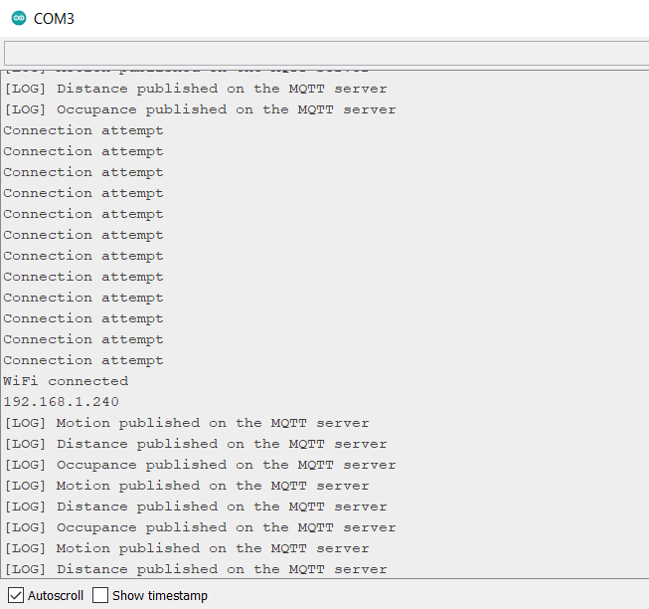
Sending and receiving data through MQTT broker

Slide 5
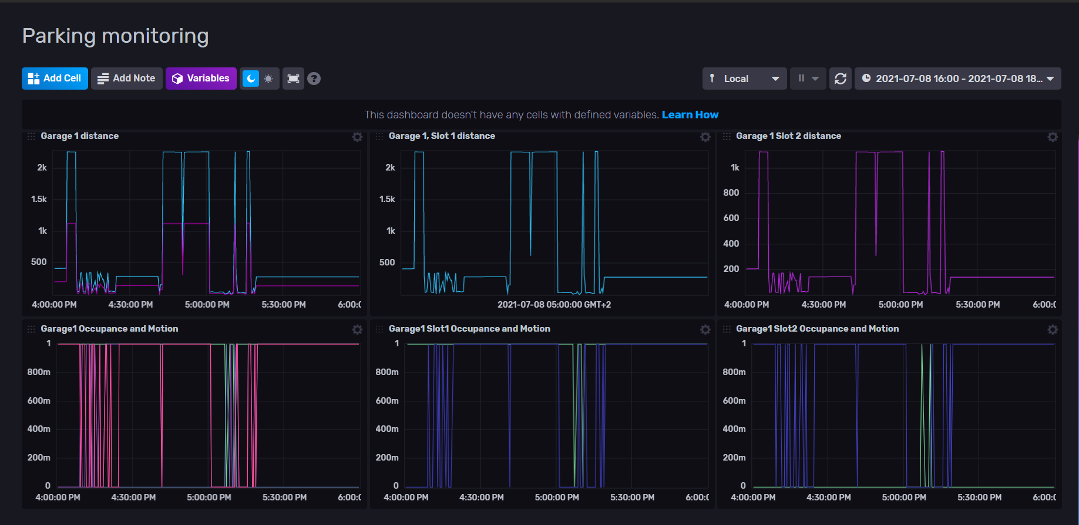
Receiving data in the influx database

Slide 6
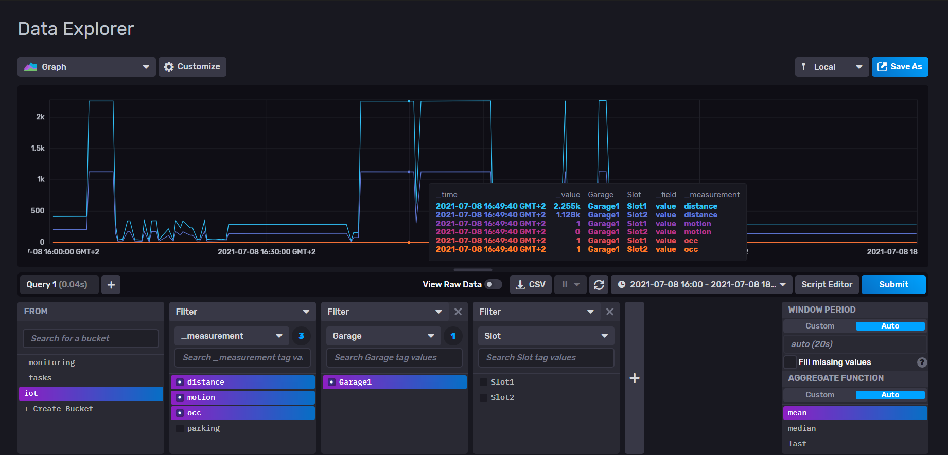
Receiving data in the influx database

Slide 7
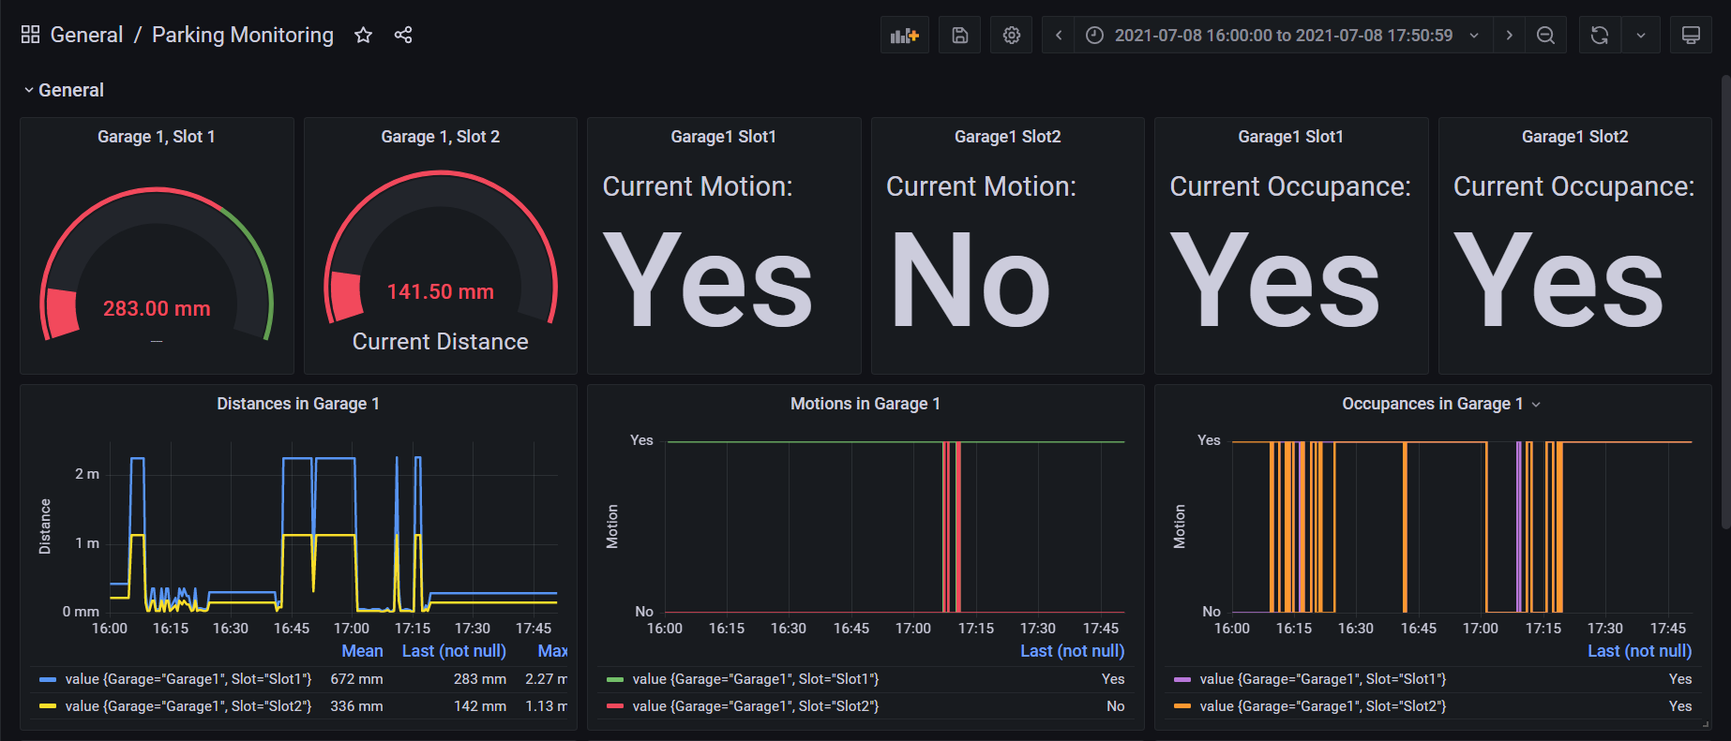
Visualizing data in grafana

Slide 8
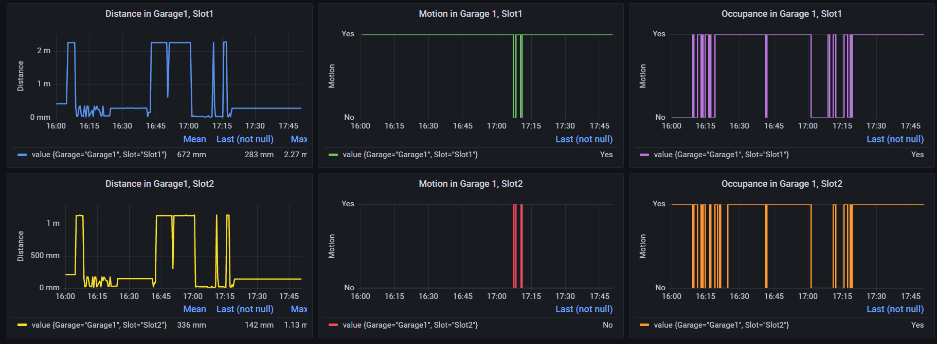
Visualizing data in grafana

